Slide 1
Principles of responsible AI development
Julia Ive

Slide 2
Session Outline
NLP Overview
Responsible AI development: key principles, their problems and solutions
Fairness
Privacy
Transparency
Accountability
Sustainability
Key Takeaways
Learning Outcomes
Spot major AI ethics issues of real-life production systems
Identify ways to mitigate those issues

Slide 3

Artificial Intelligence in Real Life: COVID
Analytical tools:
Diagnosis, prognosis, analysis of epidemic trends
Pharma industry:
Drugs and vaccines discovery
Wellbeing sector:
Mental support with self-isolation
https://www.reuters.com/article/uk-health-coronavirus-italy-robots-idUKKBN21J68H?edition-redirect=uk/

Slide 4
Artificial Intelligence in Real Life: Chatbot Errors
Large pre-trained language models are supporting applications such as speech recognition, writing aids, chatbots, etc.
Models themselves do not exhibit deep understanding of the texts that they process, fundamentally limiting their utility in many sensitive applications
Generation of toxic, biased or inappropriate content: https://artificialintelligence-news.com/2020/10/28/medical-chatbot-openai-gpt3-patient-kill-themselves
https://blog.boxmode.com/funniest-chatbot-fails

Slide 5
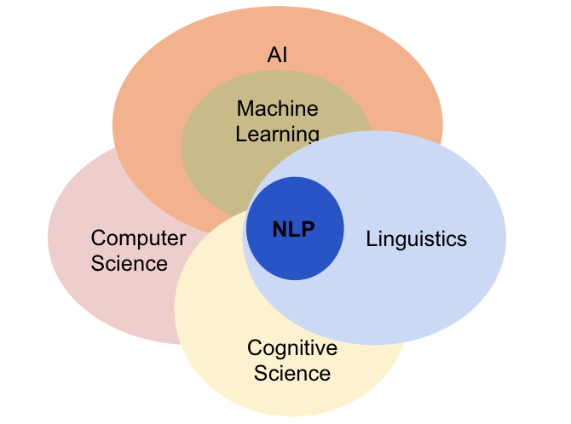
Natural Language Processing (NLP)
Processing of natural language by computers for a task

Slide 6
Natural Language Processing (NLP)
Analysis:
Extracted Information
Labels
Scores
Synthesis:
Text
Summaries
Reports
Written/Spoken text
Images, videos, tables…

Slide 7
Fairness: Problems
Predictive bias is a situation in which AI is found to give systematically different predictions for subgroups of population that are in reality identical
Current data-driven AI learns from datasets that may contain bias and discrimination
Small differences between human attributes with respect to the objective could be amplified by the model to be much more pronounced in the predicted outcomes
Examples of bias in NLP:
Caption generation incorrectly predicts agent to be a male because there is a computer nearby
Language models gives higher probability to the sentence “He is a doctor” than to the sentence “She is a doctor”
Sentiment analysis models predict higher anger score for sentences with female pronouns

Slide 8
Fairness: Solutions
Define the scope of stakeholding
Get their input on problem formulation and potential bias mitigation
For example, for demographic attributes in the data that will be important to control
Carefully analyse and re-stratify the data if needed
Mitigate bias in the model via re-weighting of examples or data augmentation techniques:
For example, “The doctor went to the room and he grabbed the syringe” could be augmented to “The doctor went to the room and she grabbed the syringe”
More in Lesson AI1.2. Algorithms and tools for mitigating bias

Slide 9
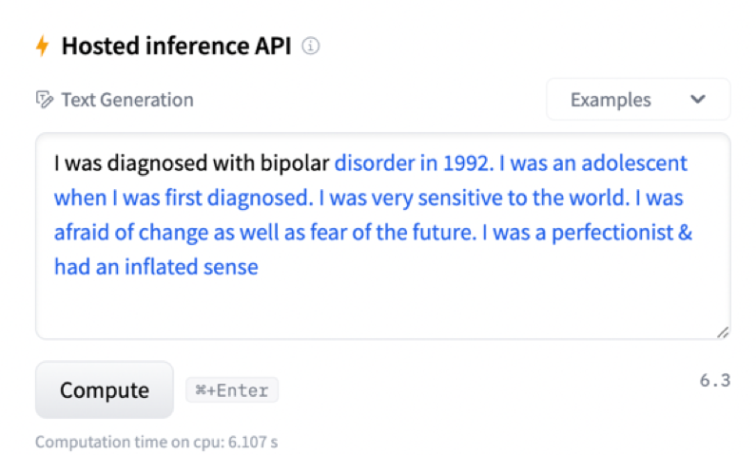
Privacy: Problems
Text has the potential to contain significant amounts of personal information
More and more societal concerns are being raised about the extensive sharing of data, data ownership monopolisation and its further irresponsible usage: https://www.theguardian.com/society/2022/feb/19/mental-health-helpline-funded-by-royals-shared-users-conversations
NLP models tend to memorise the training data and can either:
Training data can not be reconstructed from trainable model parameters
Can reproduce them once prompted
https://huggingface.co/EleutherAI/gpt-neo-1.3B

Slide 10
Privacy: Solutions
Carefully observe compliance requirements (e.g., GDPR)
Protect data:
Use anonymisation and pseudonymisation techniques (understand their flaws before using them)
K-anonymity (1998, Sweeney & Samarati) – make quasi-identifiers look alike (e.g., age could be a range)
Protect models by using techniques to prevent memorisation:
Differential Privacy - method to get aggregate statistics over training examples by adding noise to the model updates during learning
Federated Learning – learn aggregated model by averaging over distributed groups of training examples
More in Lesson AI1.3. Algorithms and tools for preserving privacy

Slide 11
Transparency: Problems
Data-driven machine learning methods are not that intuitive
Learning from experience without clearly defined defined human-readable relations
State-of-the-art neural AI models are “black boxes”:
They can approximate any function
However, they do not provide any insight on the function being approximated
Human apple
shape
color
size
AI apple
0.92
0.57
0.43

Slide 12
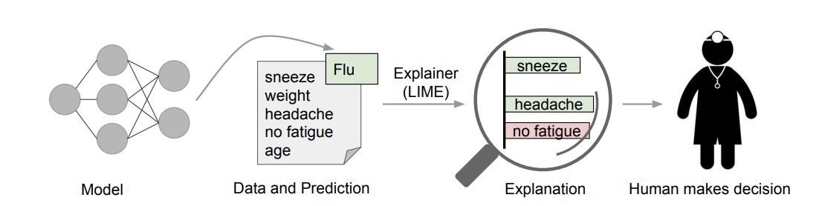
Transparency: Solutions
Ethically permissible design, implementation and outcome of the AI system
Ability of the AI system to explain its decisions:
Use supplemental approaches that explain model predictions with rationales (e.g., LIME, SHAP)
Present those explanations in natural language
Keep humans in the loop to validate outcomes
More in Lesson AI2.1. Introduction into transparency in NLP
(Ribeiro et. al , 2016)

Slide 13
Accountability: Problems
Limited records on the design and implementation of models
Tendency to produce boiler-plate text without a meaningful consideration of the relevant ethical issues
Ethical issues are not anticipated at the design stage
Ethics considerations apply at the levels of individual projects

Slide 14
Accountability: Solutions
Establish the culture of openness to scrutiny and review
Begin the design stage with ethics in mind
Ethics sheets for AI tasks aggregate relevant ethical considerations for a task by answering such questions as:
Why should we automate this task?
What social and cultural forces motivate choices in task design, data, methodology, and evaluation?
How is the automation of the task going to impact various groups of people?
How can the automated systems be abused?

Slide 15
Accountability: Solutions
For example, before designing a model to detect personality traits from one’s utterances, we can ask the following questions:
What are the societal implications of automating personality trait detection?
How can such a system be misused?
Is there enough scientific basis for personality trait identification?
Which theory of personality traits should such model build on?
What are the implications of that choice?
More in AI1.4. Ethical sheets for NLP applications

Slide 16
Sustainability: Problems
Amount of computational resources required for training and usage of state-of-the-art models has increased 300,000 x in 6 years
Most of cloud compute energy is not from renewable sources and many energy sources are not carbon neutral
For example, the training of the Transformer big model emits 284t of CO2
Re-training of a Machine Translation model for just a minor improvement requires $150,000 of additional compute cost in addition to the carbon emissions

Slide 17

Sustainability: Solutions
Report training time and sensitivity to hyperparameters with released models to avoid redundant training
Prioritise computationally efficient hardware and algorithms
Run experiments in carbon friendly regions, report energy and carbon metrics,
Consider energy-performance trade-offs before deploying energy greedy models
Use special tools to benchmark the energy usage: for example, https://codecarbon.io
https://pixabay.com/illustrations/leaves-light-bulb-sustainability-5591442/

Slide 18
Key Takeaways
Reflect on the potential ethical implications while designing your model
What are the societal implications of its usage?
What are the privacy implications?
Will it build trust?
Is it sustainable?
Implement responsibly and keep design transparent
Keep users and stakeholders in the loop

